Slide 1
Stock price analysis of the past to predict the future.
By Ashwini, Ope, Amy, Jaejun, and Gayatri

Slide 2
Analysis and Findings:
We analyzed: FAANGG for Period: January 1,2017 - December 31,2017
Apple(AAPL)
Amazon(AMZN)
Facebook(FB)
Google(GOOG)
Netflix(NFLX) and
Gold(GLD)

Slide 3
Hypothesis: Future stock prices can be predicted from past performance.
Questions considered:
What is the everyday price-change?
What’s the change in stock’s price, and daily return average over time?
Is there any correlation between daily returns of different stocks?
How much value do we put at risk by investing in a particular stock?
How to determine the trend of the stock-price and predict the future?
How do we predict the future price?
Do social media (e.g., Twitter) impact daily changes in stock-price?

Slide 4
Data Exploration and Clean-up :
Source to collect data: google finance, twitter
Problems faced during data gathering:
Yahoo finance website is being deprecated.
Morningstar data was working fine, but was not in the form that we wanted.
Not able to retrieve data from Google finance on last minute, a day before the presentation.
So, chose Google Finance as data source.
The data we got was pretty clean.
Notes:
There was a notice of unstable API. So, we matched the numbers with Morningstar data just to check if the numbers are correct. They were same, so, we ended up taking the data from Google.
All rows and columns have data, and, we didn’t have to clean it.
Not able to retrieve data from Google finance on last minute was working fine until yesterday, but suddenly stop cooperating. So couldn’t get the data for AAPLE when I ran the code Friday morning.
But luckily, we had made the copy of it and had sent it to repo. So we are good.☺

Slide 5
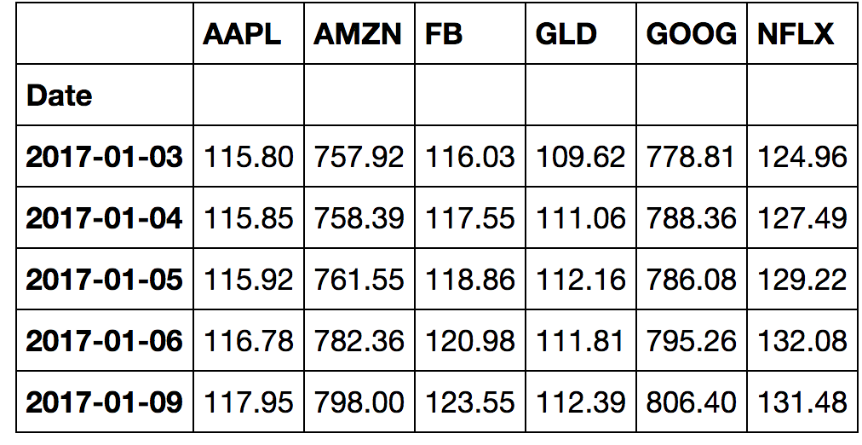
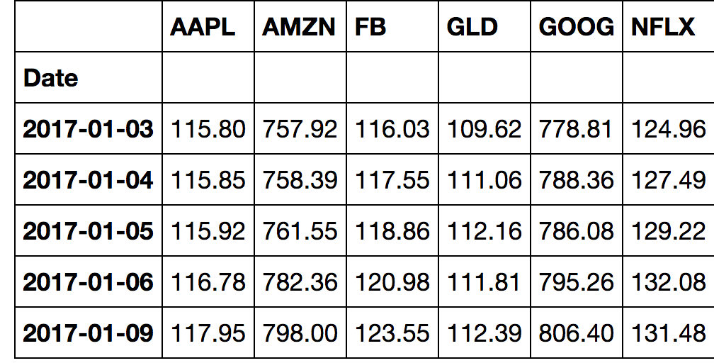
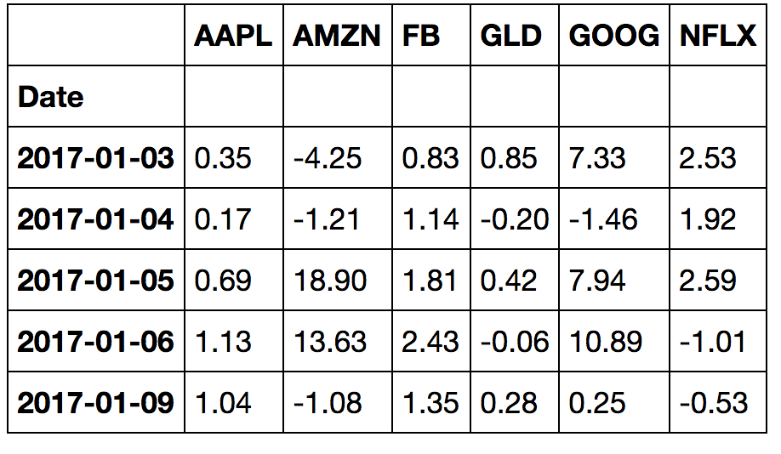
Opening , Closing Prices and the Daily Change tables
Opening Price
Closing Prices
Daily Change

Slide 6
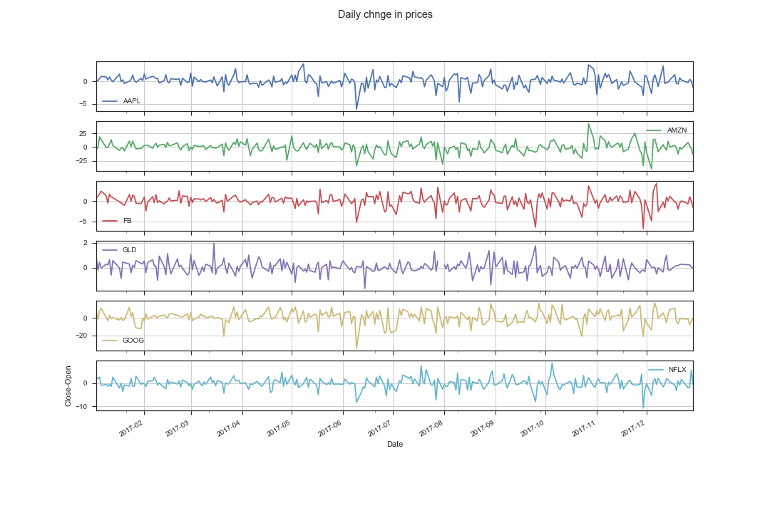
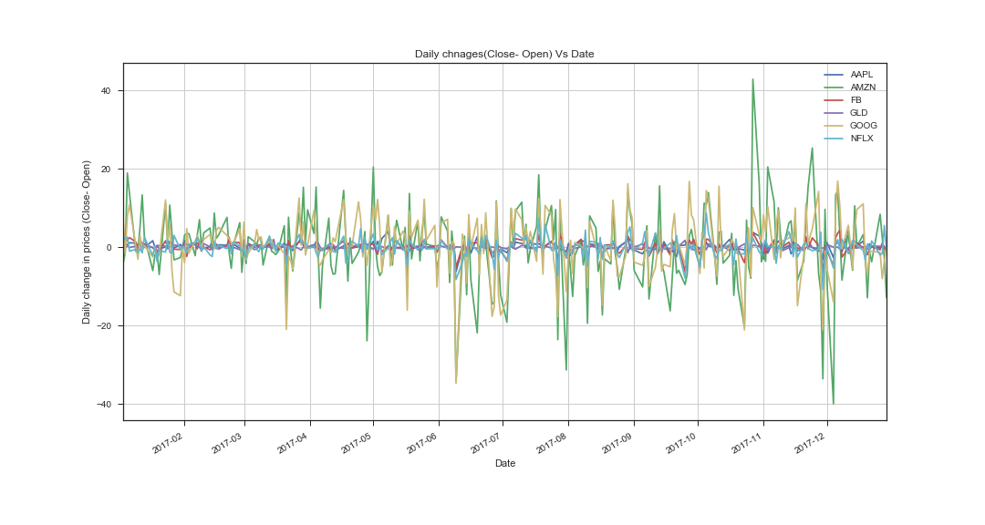
Plots/subplots: Change in prices Vs Date
Conclusion: From the graph, we can noticed that the, Google and Amazon stocks are fluctuating a lot. Amazon goes 40 points higher in the month of Nov2017 and goes down in 40 points in Dec.

Slide 7
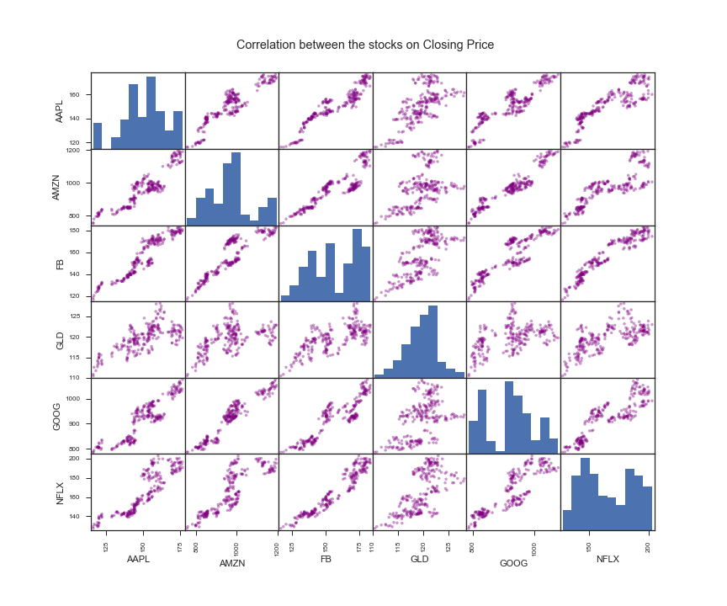
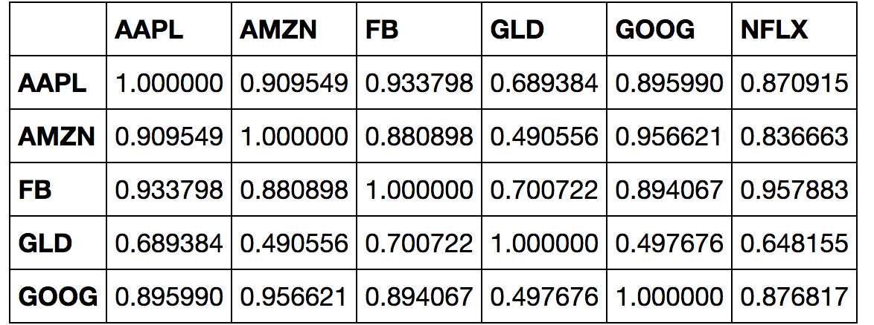
Correlation–coefficient table of closing price for all stocks:
All tech-stocks are strongly correlated to each other.
Gold(GLD) is relatively weakly correlated.
( Check out the table above and the next slid)
Hence GLD stock is one of the recommendations to have diversified well balanced portfolio.
Notes:
On this slid we can see the correlation-coefficient for all stocks.
From the matrix, it is pretty clear that the Closing Prices of the stocks do depend on one another.
i.e all tech stocks are more or less positively correlated to each other
FB prices are strongly positively correlated to AAPL,AMZN,GOOG and NFXL, except GLD.
In fact, whereas the Gold(GLD) prices are not getting affected by the prices of the other Tech stocks.
This indicates that there is a weak correlation between GLD and other stocks in the list. Take a close look at it on next slid.

Slide 8
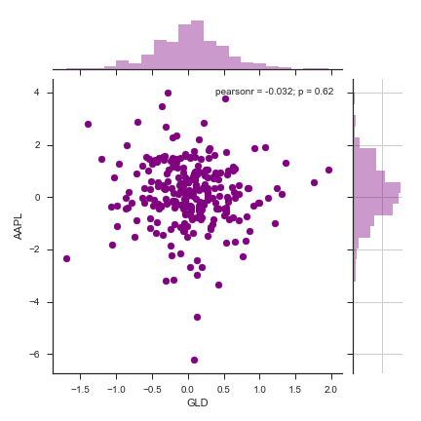
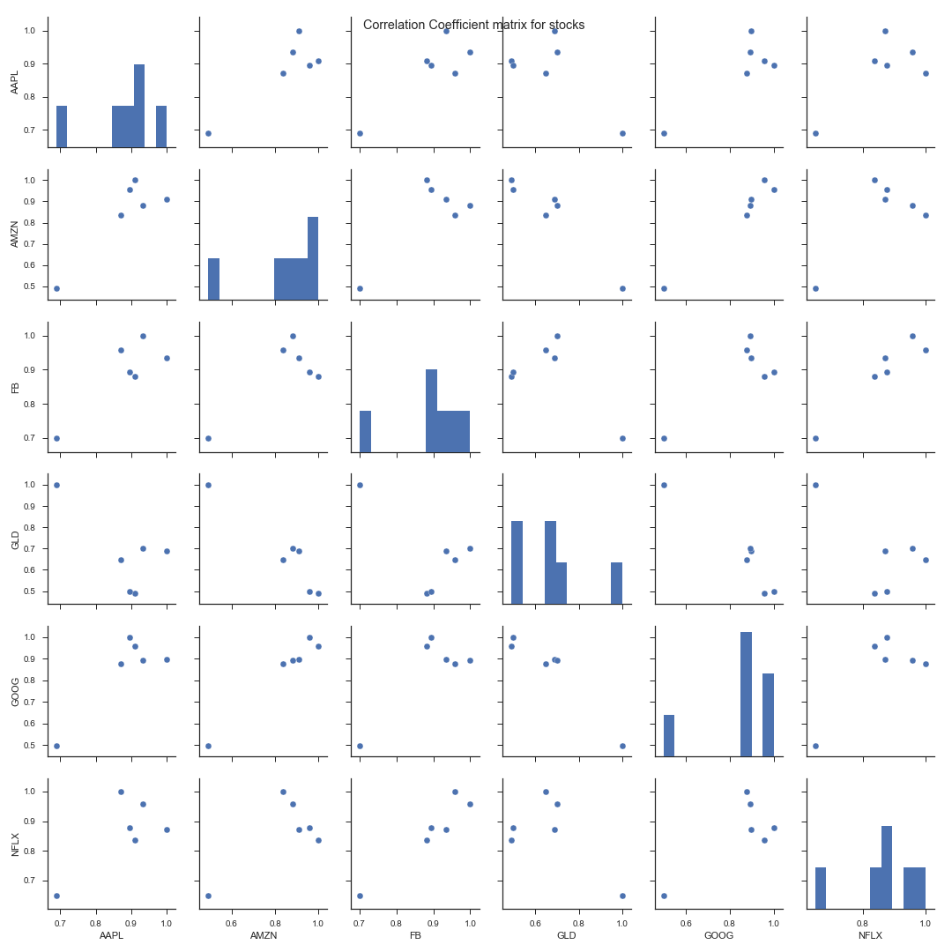
Correlation and Correlation -coefficient matrix for stocks:
Correlation-coefficient matrix
Pearson r = -o.032, p = 0.62
Low p-value Strong correlation and vice-versa.
GLD is weakly correlated to AAPL( p-value is high)
Notes:
Why buying a Gold stock is recommended?
So, buying GLD stocks will be a good idea to have diversified well-balanced portfolio.
Pearson r = -o.032, p = 0.62
(GLD is negatively correlated to AAPL)
p is the corr-coeff’s probability that the relationship between two variables is zero.
Strong relationship low p-values
See here. P =0.62. That indicates that there is very weak corr.

Slide 9
Value at Risk:
“Value at Risk:” Measure of the Risk of loss for an investment.
Estimates how much a set of investments might loose in a set time period in normal market conditions.
Value put at risk by investing in a particular stock:
Calculated by comparing its expected return with the standard deviation of daily returns.
Expected return = Mean of stock’s daily returns.
Notes:
So, let’s look at risk calculations for these stocks.
So, what is value at risk? It’s the measure of the Risk of loss for an investment. It estimates how much a set of investment might loose in a set time period in normal market conditions.
How much value do we put at risk by investing in a particular stock??
We will use various functions of pandas.

Slide 10
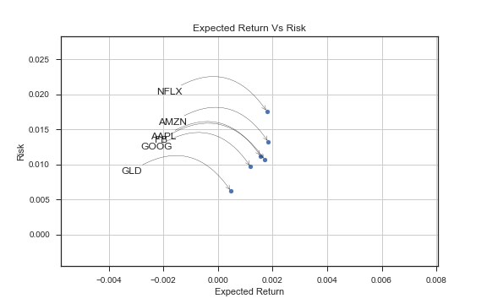
Risk Analysis:
We want high return, low risk stocks.
GLD seems to be the low risk low return socks in the entire list.
GOOG is the low risk low return among tech stocks.
NFLX has the highest return with highest risk.
Risk and returns for FB and AAPL are almost the same.
Notes:
“GOOG is the low risk low return among tech stocks.” This sounds counter intuitive, but, this is only relative to the stocks we have analyzed.☺

Slide 11
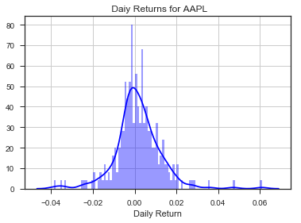
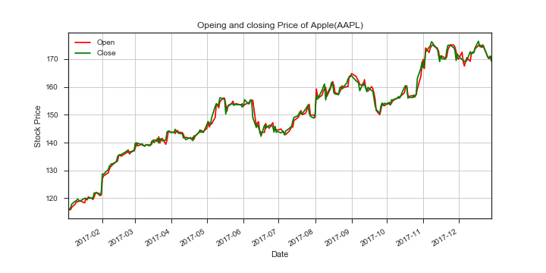
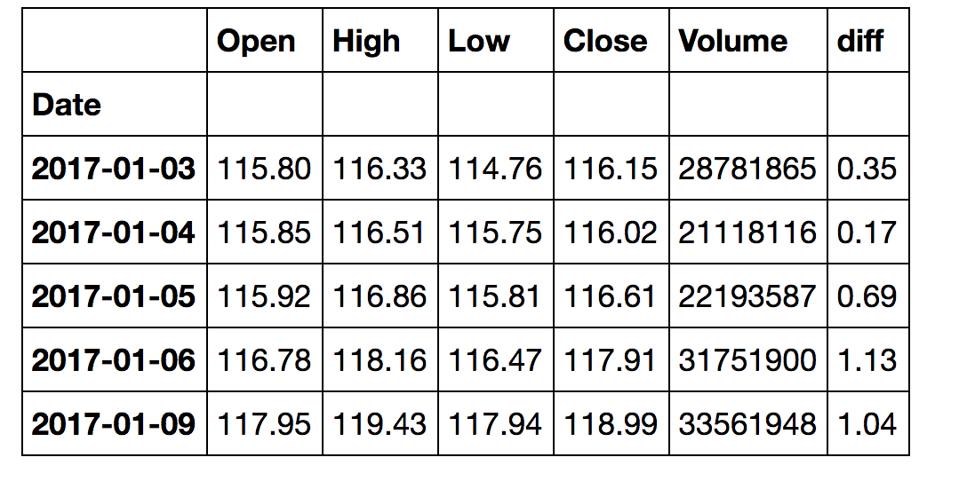
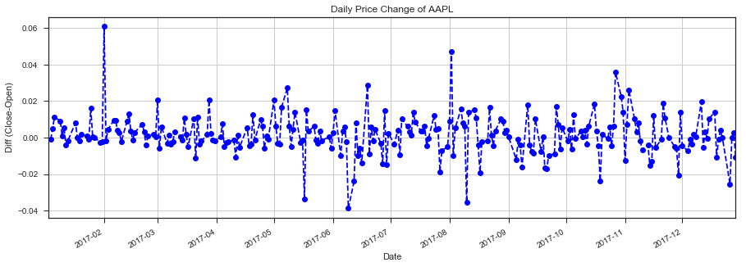
Analysis of AAPL stock
Notes:
Now we will analyze the individual stock. We have done it for Apple, and, the the process will be the same for the rest of the stock.

Slide 12
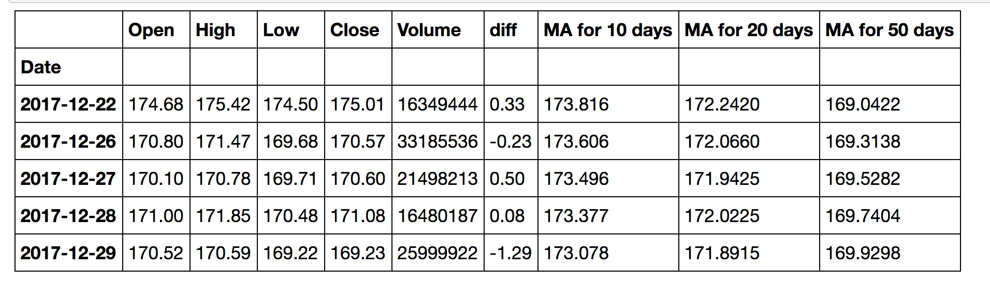
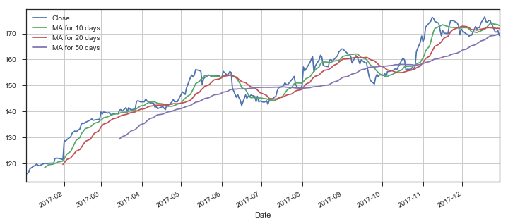
Moving Averages for AAPL:
Notes:
Moving average is the technique to get an overall idea of the trend in the data set.
It is extremely useful in forecasting the long-term trend.
So, according to this table, the predicted closing price for the AAPL is 173.816, 173.816, 173.816 respectively depending which MA we consider.
Now let’s see if our predictions are true.

Slide 13
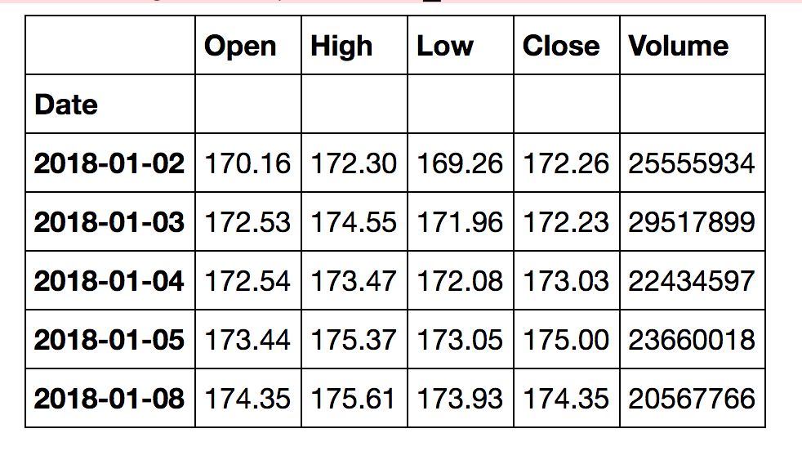
Comparison of AAPL
← AAPL Data for Jan,2018
← AAPL Data for Jan, 2018
Conclusion:
10-day and 20-day MA shows,
The Predicted price is very close to the Actual closing price of AAPL
Check:

Slide 14
Conclusion:
Our Hypothesis: Future stock prices can be predicted from past performance
is True.

